Slide 1
Data Analytics
Arcot (Raja) Rajasekar
rajasekar@unc.edu
Unit #05

Slide 2
Unit #05
Data Mining
  Basket Analysis
  Artificial Neural Networks
  Genetic Algorithms

Slide 3
Apriori Algorithm
Mining Association Rules

Slide 4
Data Mining Association Rules
Data mining is motivated by the decision support problem faced by most large retail organizations – what things do customer buy together
Bar-code technology made it possible for retail organizations to collect and store massive amounts of sales data, referred to as the basket data
For example, 98% of customers that purchase milk also buy bread
Finding all such rules is valuable for cross-marketing and attached mailing applications
Other applications include catalog design, add-on sales, store layout, and customer segmentation based on buying patterns
Databases involved in these applications are very large,
SQL cannot answer this type of query.

Slide 5
Basket Analysis:
Association rule mining
Assume all data are categorical.
Not a good algorithm for numeric data.
Initially used for Market Basket Analysis to find how items purchased by customers are related.
Rules of the form:
Bread → Milk [support = 5%, confidence = 100%]

Slide 6
ID apples, beer, cheese, dates, eggs, fish, glue, honey, ice-cream
1 | 1 | 1 |  | 1 |  |  | 1 | 1
2 |  |  | 1 | 1 | 1
3 |  | 1 | 1 |  |  | 1
4 |  | 1 |  |  |  | 1 |  |  | 1
5 |  |  |  |  | 1 |  | 1
6 |  |  |  |  |  | 1 |  |  | 1
7 | 1 |  |  | 1 |  |  |  | 1
8 |  |  |  |  |  | 1 |  |  | 1
9 |  |  | 1 |  | 1
10 |  | 1 |  |  |  |  | 1
11 |  |  |  |  | 1 |  | 1
12 | 1
13 |  |  | 1 |  |  | 1
14 |  |  | 1 |  |  | 1
15 |  |  |  |  |  |  |  | 1 | 1
16 |  |  |  | 1
17 | 1 |  |  |  |  | 1
18 | 1 | 1 | 1 | 1 |  |  |  | 1
19 | 1 | 1 |  | 1 |  |  | 1 | 1
20 |  |  |  |  | 1
David Corne, and Nick Taylor, Heriot-Watt University - dwcorne@gmail.com
These slides and related resources: http://www.macs.hw.ac.uk/~dwcorne/Teaching/dmml.html

Slide 7
Interesting/Useful rules
Statistically, anything that is interesting is something that happens significantly more than you would expect by chance.
Example:
Basic statistical analysis of basket data may show that 10% of baskets contain bread, and 4% of baskets contain washing powder.
That is, if you choose a basket at random:
  There is a probability 0.1 that it contains bread.
  There is a probability 0.04 that it contains washing-up powder.
What is the probability of a basket containing both bread and washing powder? The laws of probability say:
If these two things are independent, chance is 0.1 * 0.04 = 0.004
That is, we expect 0.4% of baskets to contain both bread and washing powder.
What if they occur together in 1% of baskets?
  Something is going on in shoppers’ minds: bread and washing powder are connected in some way.
  There may be ways to exploit this discovery … put the powder and bread at opposite ends of the supermarket?

Slide 8
Finding surprising rules
Suppose we ask `what is the most surprising rule in this database? This would be, presumably, a rule whose accuracy is more different from its expected accuracy than any others. But it also has to have a suitable level of coverage, or else it may be just a statistical blip, and/or unexploitable.

Slide 9
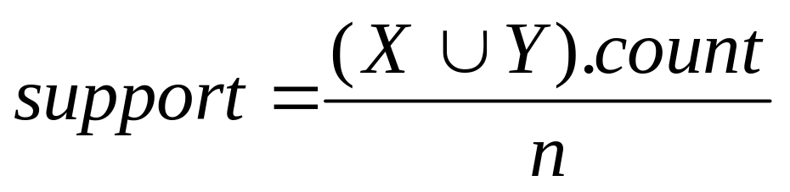
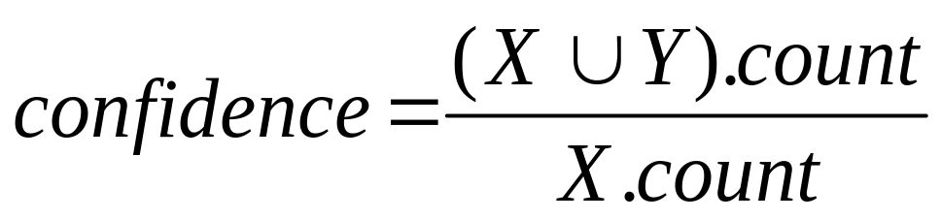
Support and Confidence
Support count: The support count of an itemset X, denoted by X.count, in a data set T is the number of transactions in T that contain X. Assume T has n transactions.
Assume a rule of the form R: X → Y
Then,

Slide 10
An example
  t1: Beef, Chicken, Milk
  t2: Beef, Cheese
  t3: Cheese, Boots
  t4: Beef, Chicken, Cheese
  t5: Beef, Chicken, Clothes, Cheese, Milk
  t6: Chicken, Clothes, Milk
  t7: Chicken, Milk, Clothes
Transaction data
Assume:
minsup = 30%
minconf = 80%
An example frequent itemset:
X= {Chicken, Clothes, Milk} [sup = 3/7]
Association rules from the itemset:
Clothes → Milk, Chicken [sup = 3/7, conf = 3/3]
… …
Chicken → Milk, Clothes [sup = 3/7, conf = 3/5]

Slide 11
Terminology
k-itemset : a set of k items. E.g.
{beer, cheese, eggs}, {clothes, chicken, eggs} are 3-itemsets
{cheese}, {eggs} are 1-itemsets
{honey, ice-cream} is a 2-itemset
minimum support (minsup): the Apriori algorithm starts with the specification of a minimum level of support, and will focus on itemsets with this level or above.
large itemset: doesn’t mean an itemset with many items. It means one whose support is at least minimum support.
L_{k} : the set of all large k-itemsets in the DB.
C_{k} : a set of candidate large k-itemsets. In the algorithm we will look at, it generates this set, which contains all the k-itemsets that might be large, and then eventually generates the set above.

Slide 12
ID a, b, c, d, e, f, g, h, i
1 | 1 | 1 |  | 1 |  |  | 1 | 1
2 |  |  | 1 | 1 | 1
3 |  | 1 | 1 |  |  | 1
4 |  | 1 |  |  |  | 1 |  |  | 1
5 |  |  |  |  | 1 |  | 1
6 |  |  |  |  |  | 1 |  |  | 1
7 | 1 |  |  | 1 |  |  |  | 1
8 |  |  |  |  |  | 1 |  |  | 1
9 |  |  | 1 |  | 1
10 |  | 1 |  |  |  |  | 1
11 |  |  |  |  | 1 |  | 1
12 | 1
13 |  |  | 1 |  |  | 1
14 |  |  | 1 |  |  | 1
15 |  |  |  |  |  |  |  | 1 | 1
16 |  |  |  | 1
17 | 1 |  |  |  |  | 1
18 | 1 | 1 | 1 | 1 |  |  |  | 1
19 | 1 | 1 |  | 1 |  |  | 1 | 1
20 |  |  |  |  | 1
E.g.
3-itemset {a,b,h}
has support 15%
2-itemset {a, i}
has support 0%
4-itemset {b, c, d, h}
has support 5%
If minimum support is
10%, then {a,b,h} is a large
itemset, but {b, c, d, h}
Is a small itemset!

Slide 13
Algorithm Apriori
L₁ = {large 1-itemsets};
for ( k = 2; L_{k-1} ≠ Ø; k++ ) do begin
C_{k} = apriori-gen(L_{k-1}); // New candidates
forall transactions t ∈ D do begin
C_{t} = subset(C_{k}, t); Candidates contained in t
forall candidates c ∈ C_{t} do
c.count++;
end
L_{k} = {c ∈ C_{k} | c.count ≥ minsup}
end
Answer = ∪_{k} L_{k};
May 21, 2002

Slide 14
Artificial
Neural Network: A Brief Overview

Slide 15
Introduction
What are ANNs?
  Neural networks are a method of programming computers without writing programs.
  Exceptionally good at pattern recognition and other tasks that are very difficult to program using conventional techniques.
  ANNs are capable of learning on their own and adapting to changing conditions.
  Novel structure of the information processing system.
    Composed of a large number of highly interconnected processing elements (neurons)
    Like people, learn by example.

Slide 16
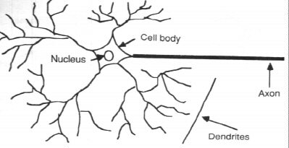
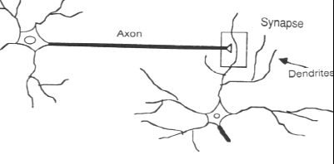
How the Human Brain learns
In the human brain, a typical neuron collects signals from others through a host of fine structures called dendrites.
The neuron sends out spikes of electrical activity through a long, thin stand known as an axon, which splits into thousands of branches.
At the end of each branch, a structure called a synapse converts the activity from the axon into electrical effects that inhibit or excite activity in the connected neurons.

Slide 17
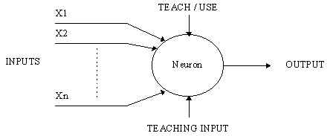
A Simple Artificial Neuron
An artificial neuron is a device with many inputs and one output.
The neuron has two modes of operation;
  training phase and usage phase.
Pattern recognition can be implemented by using a feed-forward neural network that has been trained accordingly.
the network is trained to associate outputs with input patterns.
When used, it identifies the input pattern and tries to output the associated output pattern.
The power of neural networks to find matching patterns different from learned pattern

Slide 18
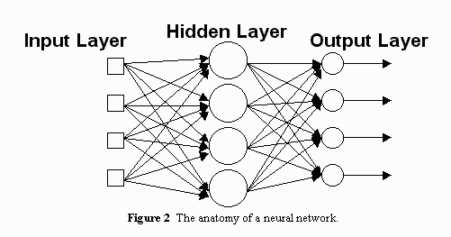
Simple Neural Network
Input Layer - The activity of the input units represents the raw information fed into the network.
Hidden Layer - The activity of each hidden unit is determined by the activities of the input units and the weights on the connections between the input and the hidden units.
The weights between the input and hidden units determine when each hidden unit is active, and modifying these weights, a hidden unit can choose what it represents
Output Layer - The behavior of the output units depends on the activity of the hidden units and the weights between the hidden and output units.
The number of layers and neurons depend on specific task. In practice solved by trial and error.
How are the weights initialized?
How many hidden layers and how many neurons?
How many examples in the training set?

Slide 19
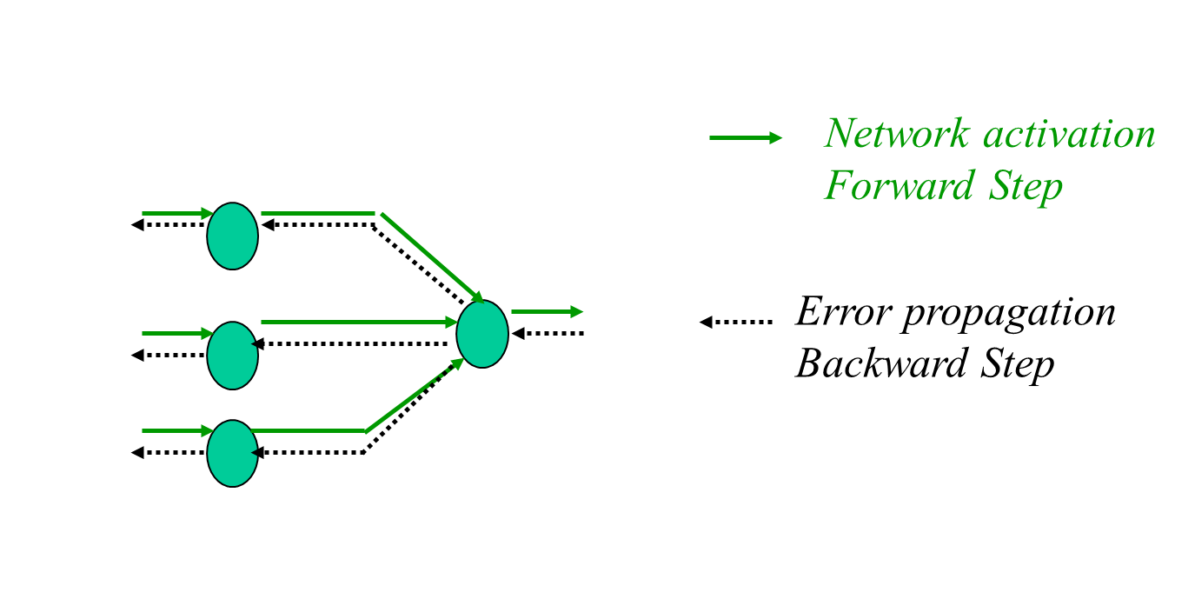
Training: Backprop algorithm
The Backprop algorithm searches for weight values that minimize the total error of the network over the set of training examples
Backprop consists of repeated application of the following two passes:
  Forward pass: the network is activated on one example and the error of (each neuron of) the output layer is computed.
  Backward pass: the network error is used for updating the weights. Starting at the output layer, the error is propagated backwards through the network, layer by layer. This is done by recursively computing the local gradient of each neuron.

Slide 20
Neural Network in Use
Since neural networks are best at identifying patterns or trends
in data, they are well suited for prediction or forecasting
needs including:
  sales forecasting
  industrial process control
  customer research
  data validation
  risk management
  Medical diagnostics
\

Slide 21
Disadvantage of Neural Network
The individual relations between the input variables and the output variables are not developed by engineering judgment so that the model tends to be a black box or input/output table without analytical basis.
The sample size has to be large.
Requires lot of trial and error so training can be time consuming.

Slide 22
Genetic Algorithms

Slide 23
Simple GA Operations
Representation | Binary strings
Reproduction | Generations
Recombination/Crossover | N-point or uniform
Mutation | Bitwise bit-flipping with fixed probability
Parent selection | Fitness-Proportionate
Survivor selection | All children replace parents
Speciality | Types of crossover, selection and mutation

Slide 24
Representation
Phenotype space
Genotype space = {0,1}^{L}
Encoding
(representation)
10010001
10010010
010001001
011101001
Decoding
(inverse representation)

Slide 25
SGA reproduction cycle
Select parents for the mating pool
(size of mating pool = population size)
Shuffle the mating pool
For each consecutive pair apply crossover with probability p_{c} , otherwise copy parents
For each offspring apply mutation (bit-flip with probability p_{m} independently for each bit)
Replace the whole population with the resulting offspring

Slide 26
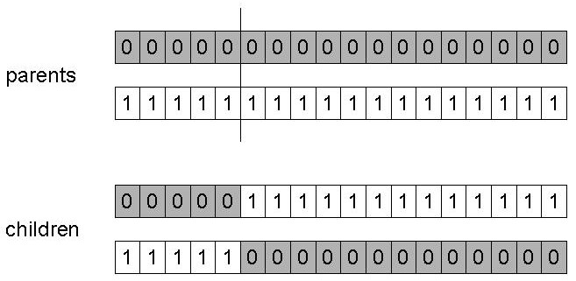
SGA operators: 1-point crossover
Choose a random point on the two parents
Split parents at this crossover point
Create children by exchanging tails
P_{c} typically in range (0.6, 0.9)

Slide 27
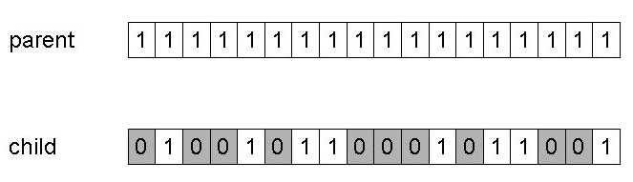
SGA operators: mutation
Alter each gene independently with a probability p_{m}
p_{m} is called the mutation rate
  Typically between 1/pop_size and 1/ chromosome_length

Slide 28
SGA operators: Selection
Main idea: better individuals get higher chance
  Chances proportional to fitness
  Implementation: roulette wheel technique
        Assign to each individual a part of the roulette wheel
        Spin the wheel n times to select n individuals
1/6 = 17%
B
fitness(A) = 3
A
C
fitness(B) = 1
3/6 = 50%
2/6 = 33%
fitness(C) = 2

Slide 29
Crossover vs. Mutation?
Exploration: Discovering promising areas in the search space, i.e. gaining information on the problem
Exploitation: Optimising within a promising area, i.e. using information
There is co-operation AND competition between them
Crossover is explorative, it makes a big jump to an area somewhere “in between” two (parent) areas
Mutation is exploitative, it creates random small diversions, thereby staying near (in the area of ) the parent
Only crossover can combine information from two parents
Only mutation can introduce new information (alleles)
Crossover does not change the allele frequencies of the population (thought experiment: 50% 0’s on first bit in the population, ?% after performing n crossovers)
To hit the optimum you often need a ‘lucky’ mutation

